Slide 1
SCHOOL MANAGEMENT · PROJECT REVIEW
AI Learning Suite
An AI-Powered, Multi-Tenant School Management Platform
SA
A
T
S
P
Super Admin
School Admin
Teacher
Student
Parent
Angeline Jenita · Reg No. 2303917773822002
Internal Guide: T Chandrakumar, Professor
External Guide: Siva Kumar, CEO, Cultivaite Futures
[Department], Thiagarajar College Of Engineering · [Review Date]

Slide 2
PROJECT REVIEW
Agenda
1
Abstract
2
Functionalities
3
Risk Analysis
4
Database Design
5
Detailed Design (UML)
6
Implementation Status
7
Results Obtained
8
Unit Testing
9
Integration Testing
10
References
AI Learning Suite
01 / 20

Slide 3
01 · ABSTRACT
What This Project Is
AI Learning Suite is a multi-tenant school-management platform: every school gets its own isolated workspace, sharing one codebase. Five roles — Super Admin, School Admin, Teacher, Student, and Parent — each get a purpose-built dashboard instead of one generic screen stretched across every use case. The platform's defining idea is AI as a reviewed assistant, not an autonomous grader: it drafts courses, answers student questions grounded in real curriculum, and suggests rubric-by-rubric scores — but a teacher always makes the final call before anything is saved. Built on FastAPI, PostgreSQL, and React, with Anthropic Claude and Google Gemini as interchangeable AI providers chosen per school.
5
Role-based dashboards
9
FastAPI routers
2
Interchangeable AI providers
70%
Implementation complete
AI Learning Suite
02 / 20

Slide 4
02 · FUNCTIONALITIES
What The Platform Does
CC
AG
AT
GR
Course & Curriculum
Assignments & Grading
Attendance
Grades & Reports
Courses → Modules → Lessons, authored manually or generated by AI.
Quizzes auto-grade instantly; written work gets AI-assisted rubric or answer-key grading.
Teachers mark it per class; students and parents see it in real time.
Class rosters, report cards, and Excel / PDF export.
GM
AN
TA
CX
Gamification
Announcements & Discussions
Multi-Tenant Admin
Trust & Compliance
Challenges, Fun Games, and a Gamified Match assignment type.
School- and course-level updates, plus threaded course Q&A.
Super Admin manages schools, subscriptions, and platform-wide settings.
RBAC, data-deletion requests, and a complaints pipeline to Super Admin.
AI Learning Suite
03 / 20

Slide 5
02 · FUNCTIONALITIES
AI Features, In Depth
Course Builder
AI Tutor
Generates a full course — modules, lessons, even from an uploaded PDF — for a teacher to edit and publish.
A student-facing chat grounded in the real course and lesson content the student is enrolled in, not generic answers.
Answer-Key Grading
Rubric Grading
For objective written answers, AI compares the submission against a teacher's key and suggests a grade.
AI scores each rubric criterion independently with a justification; points are server-clamped to that criterion's max.
Every AI suggestion is reviewed and can be overridden by a teacher before it's saved — AI drafts, humans decide.
AI Learning Suite
04 / 20

Slide 6
03 · RISK ANALYSIS
Risks & Mitigations
Risk | Category | Likelihood | Impact | Mitigation
AI hallucination in grading | Technical | Medium | High | Server-side clamps points to criterion max, drops unknown IDs; teacher review required before save.
Third-party AI provider outage / cost | Operational | Medium | Medium | Provider-agnostic AIService lets a school switch Claude ↔ Gemini with no code change.
Cross-tenant data leakage | Security | Low | Critical | Every scoped query filters by school_id from the caller's own JWT; cross-school views are explicitly tested.
Auth bypass / weak credentials | Security | Low | High | JWT + bcrypt hashing, per-route RBAC guards, rate limiting on auth endpoints.
Feature scope creep | Project | High | Medium | Every feature reviewed against a Keep / Consolidate / Cut framework each cycle.
Schema drift across environments | Technical | Medium | Medium | All schema changes ship as versioned, reversible Alembic migrations.
AI Learning Suite
05 / 20

Slide 7
04 · DATABASE DESIGN
Table Design Principles
27
Every tenant-scoped table carries a school_id foreign key — the multi-tenant boundary enforced in code on every query, not just at the database level.
SQLAlchemy 2.0 ORM models map one-to-one with versioned Alembic migrations — 27 migrations applied to date, every one reversible.
Primary keys are UUID strings, not auto-increment integers — safe to expose in a URL, safe to generate client-side.
Cascading deletes are explicit per relationship — deleting a school cascades to its users and courses; deleting a course never deletes its enrolled students.
Alembic migrations applied
20+
Tables in the schema
1 → N
Shared schema, many schools
AI Learning Suite
06 / 20

Slide 8
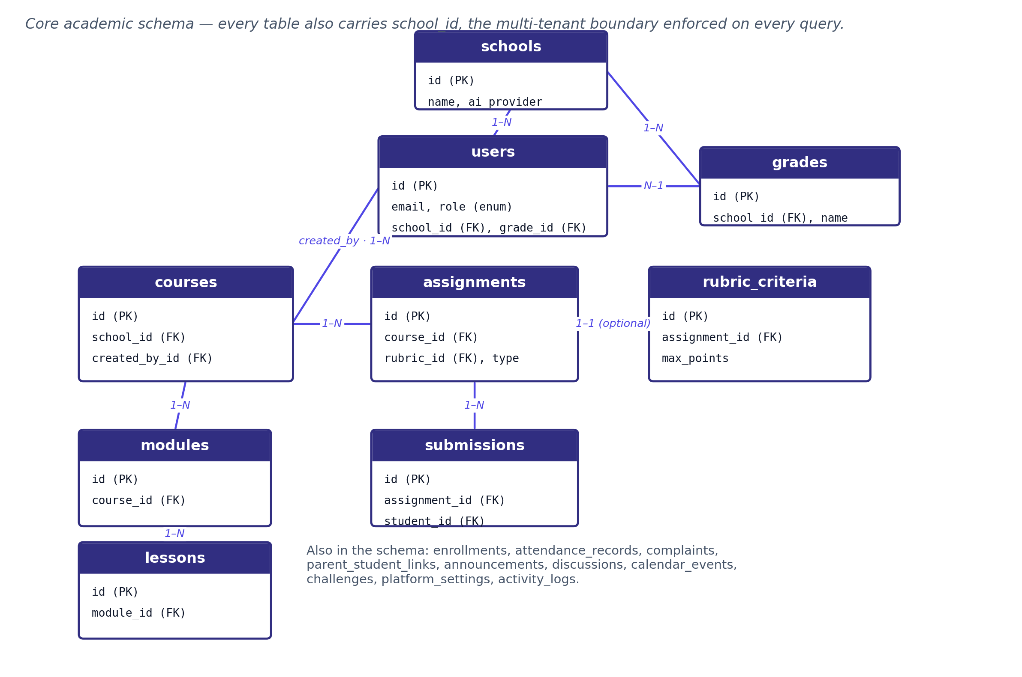
04 · DATABASE DESIGN
Entity Relationships
AI Learning Suite
07 / 20

Slide 9
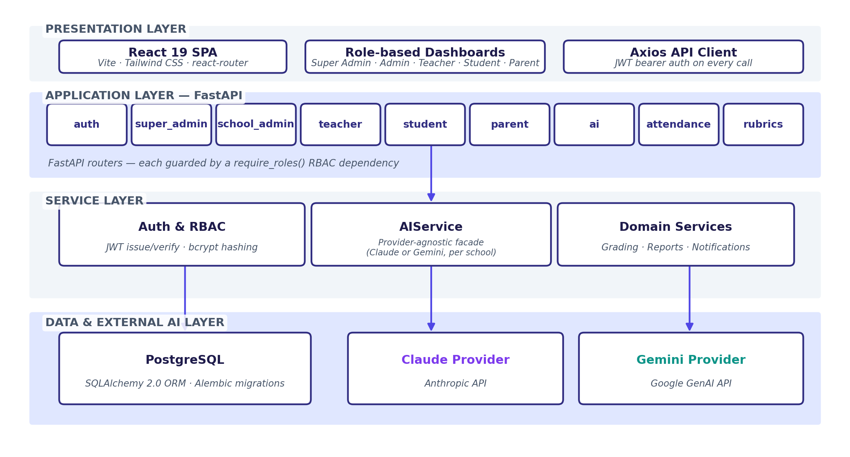
05 · DETAILED DESIGN
System Architecture
AI Learning Suite
08 / 20

Slide 10
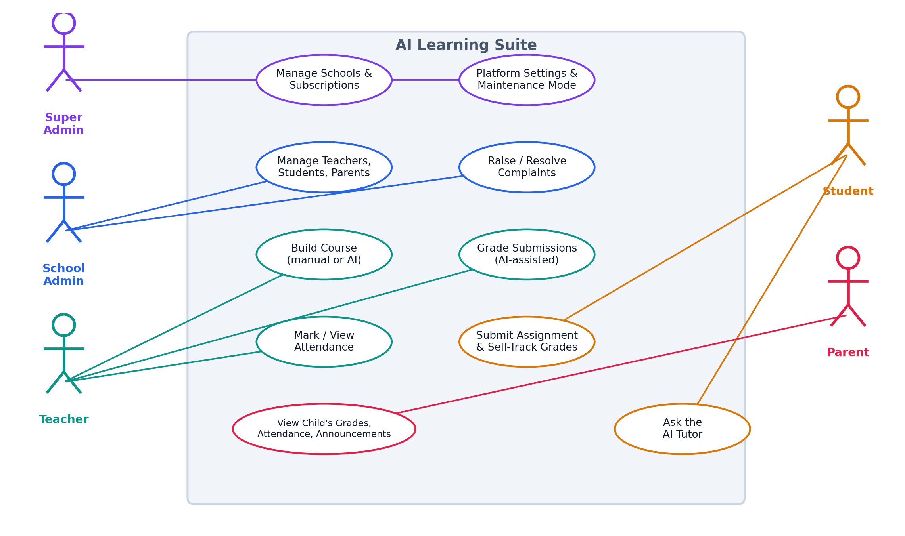
05 · DETAILED DESIGN
Use Case Diagram
AI Learning Suite
09 / 20

Slide 11
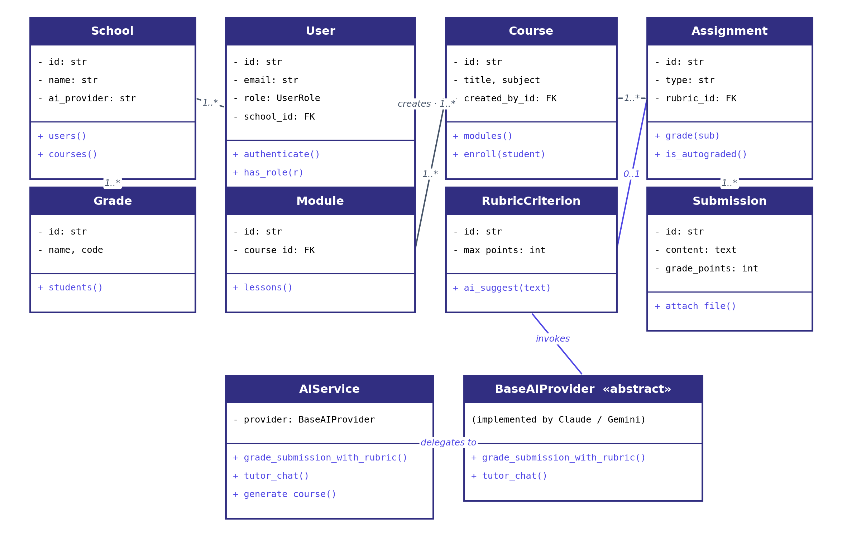
05 · DETAILED DESIGN
Class Diagram — Core Domain
AI Learning Suite
10 / 20

Slide 12
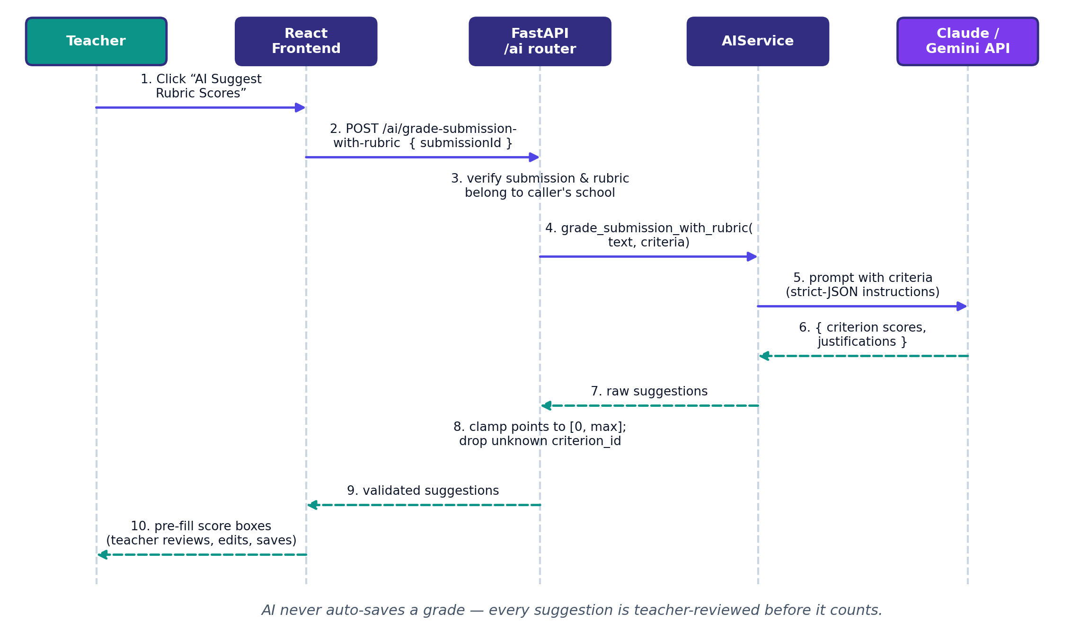
05 · DETAILED DESIGN
Sequence Diagram — AI Rubric Grading
AI Learning Suite
11 / 20

Slide 13
06 · IMPLEMENTATION STATUS
~70% Complete
Core platform — auth, roles, schools, courses
95%
70%
Academic workflows — assignments, grading, attendance
85%
AI features — tutor, course builder, rubric grading
80%
of the platform is built,
wired end-to-end, and
functionally verified.
Admin & compliance — complaints, data requests, settings
75%
Automated test coverage
55%
Deployment & production hardening
40%
Remaining for the next review: full regression suite, production deployment pipeline, and real-user (teacher/student) usability testing.
AI Learning Suite
12 / 20

Slide 14
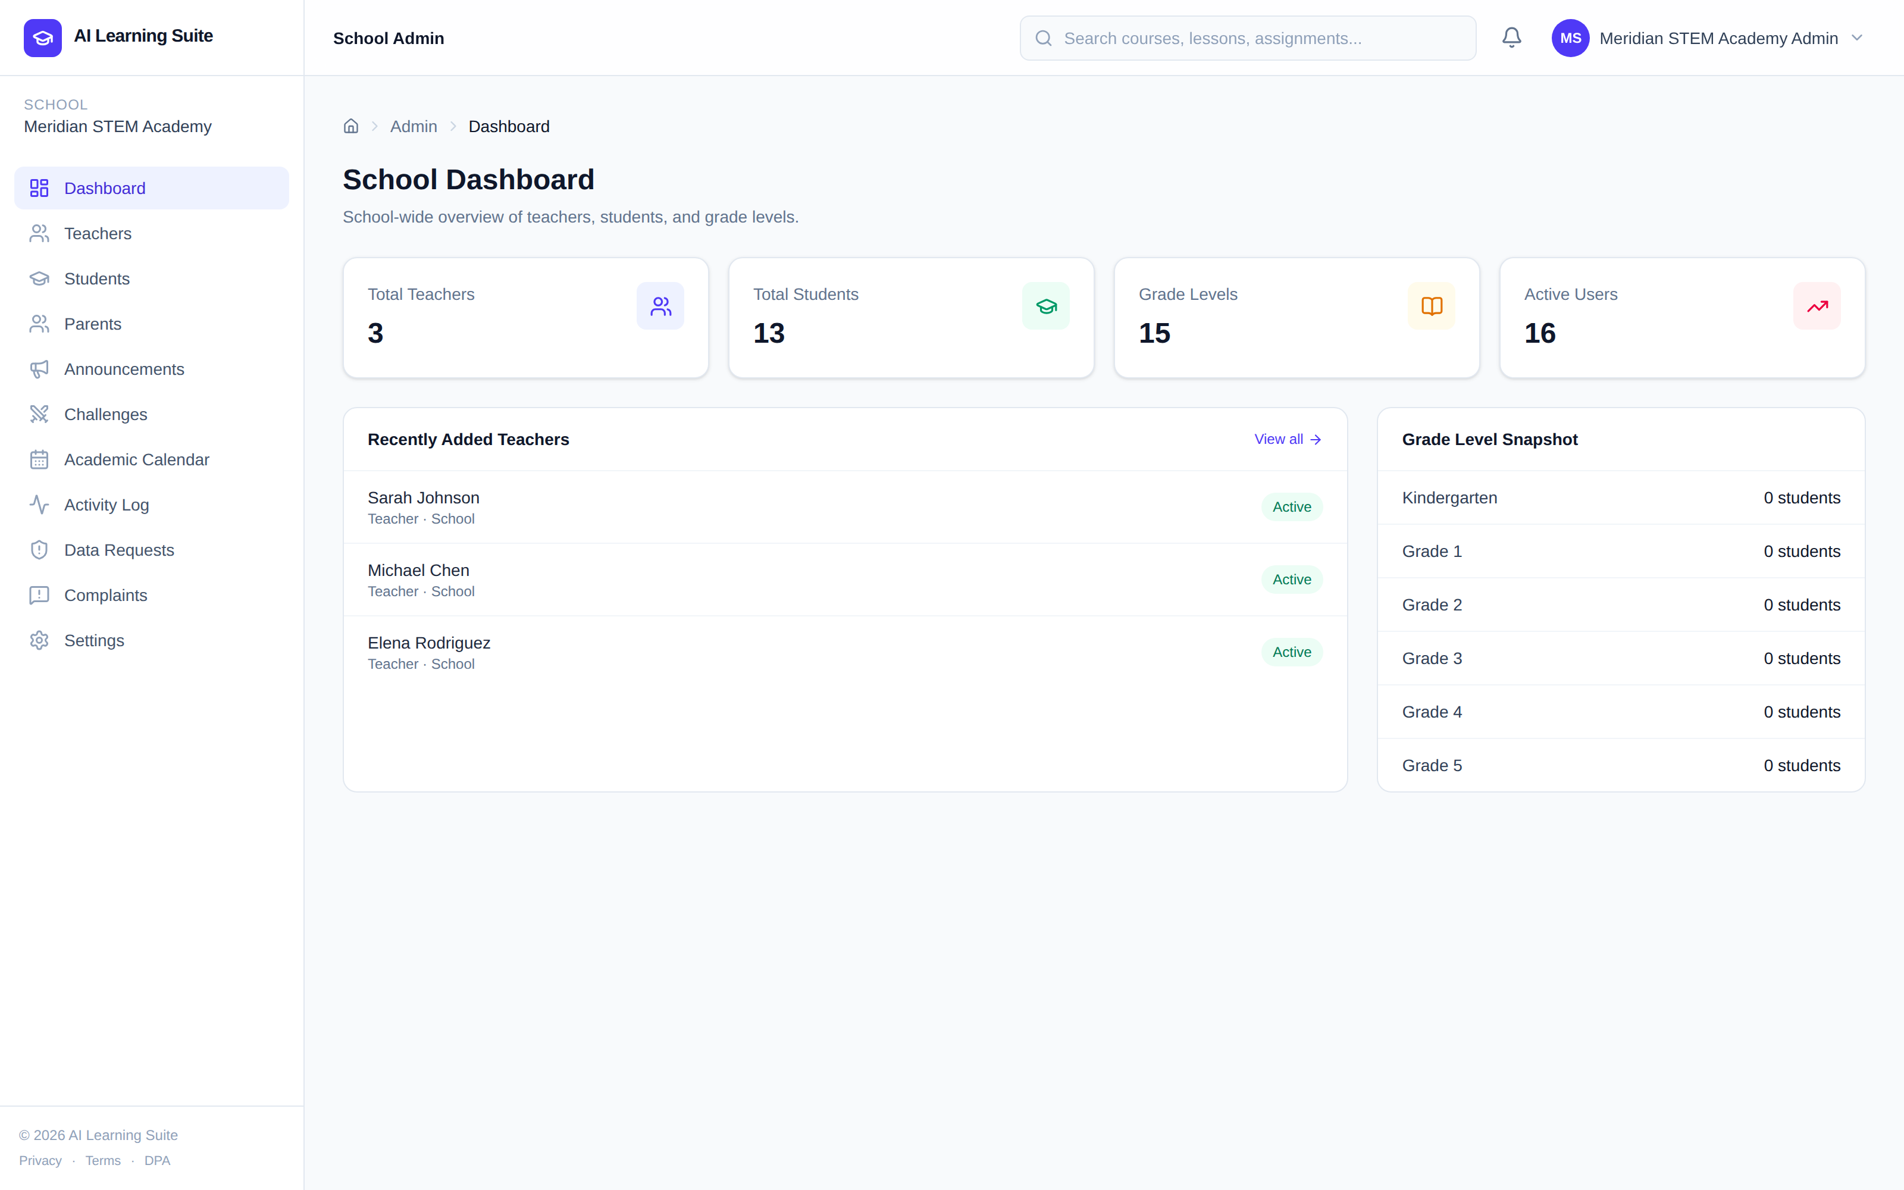
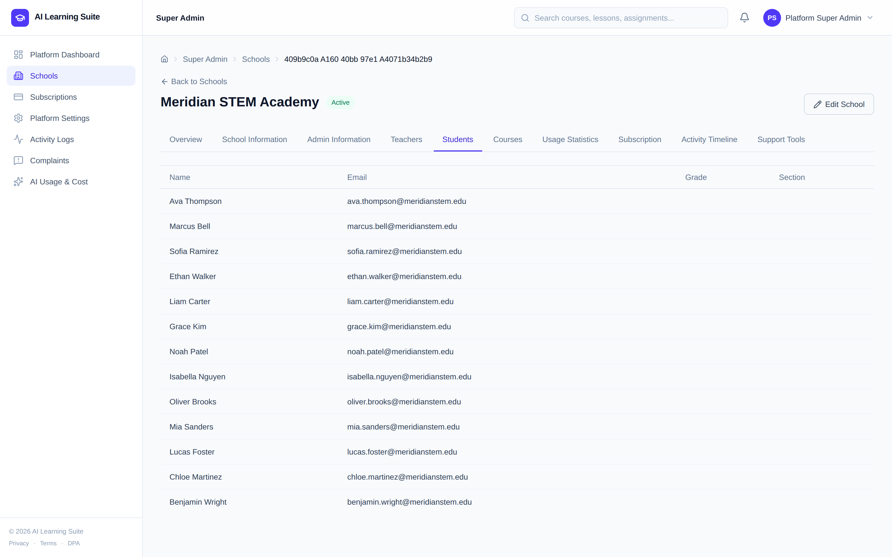
07 · RESULTS OBTAINED (INTERMEDIATE) — 1/3
Application Walkthrough
Login & role-based redirect
Super Admin — School Details (Teachers / Students / Courses)
Captured from a live, seeded instance of the application. AI-generated content (course builder, tutor chat, rubric suggestions) shown here was pre-seeded for demonstration rather than generated live, to conserve API quota.
AI Learning Suite
13 / 20

Slide 15
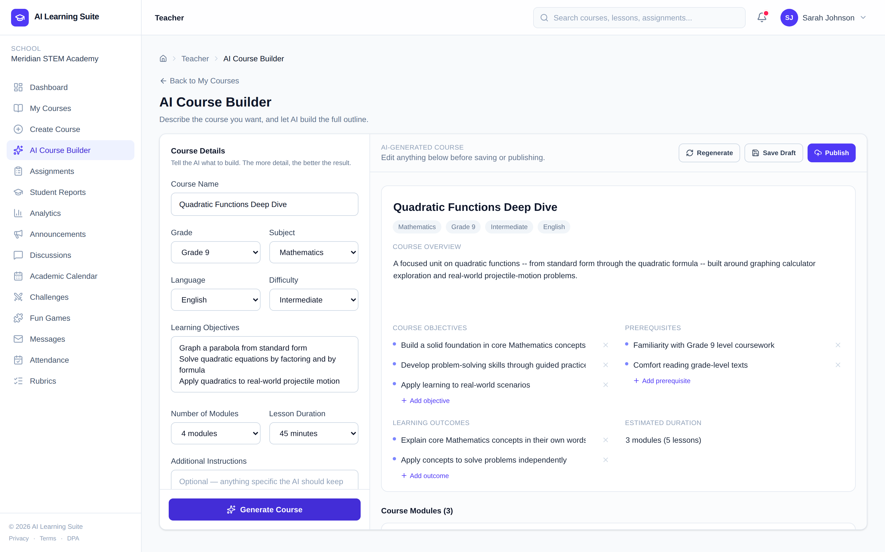
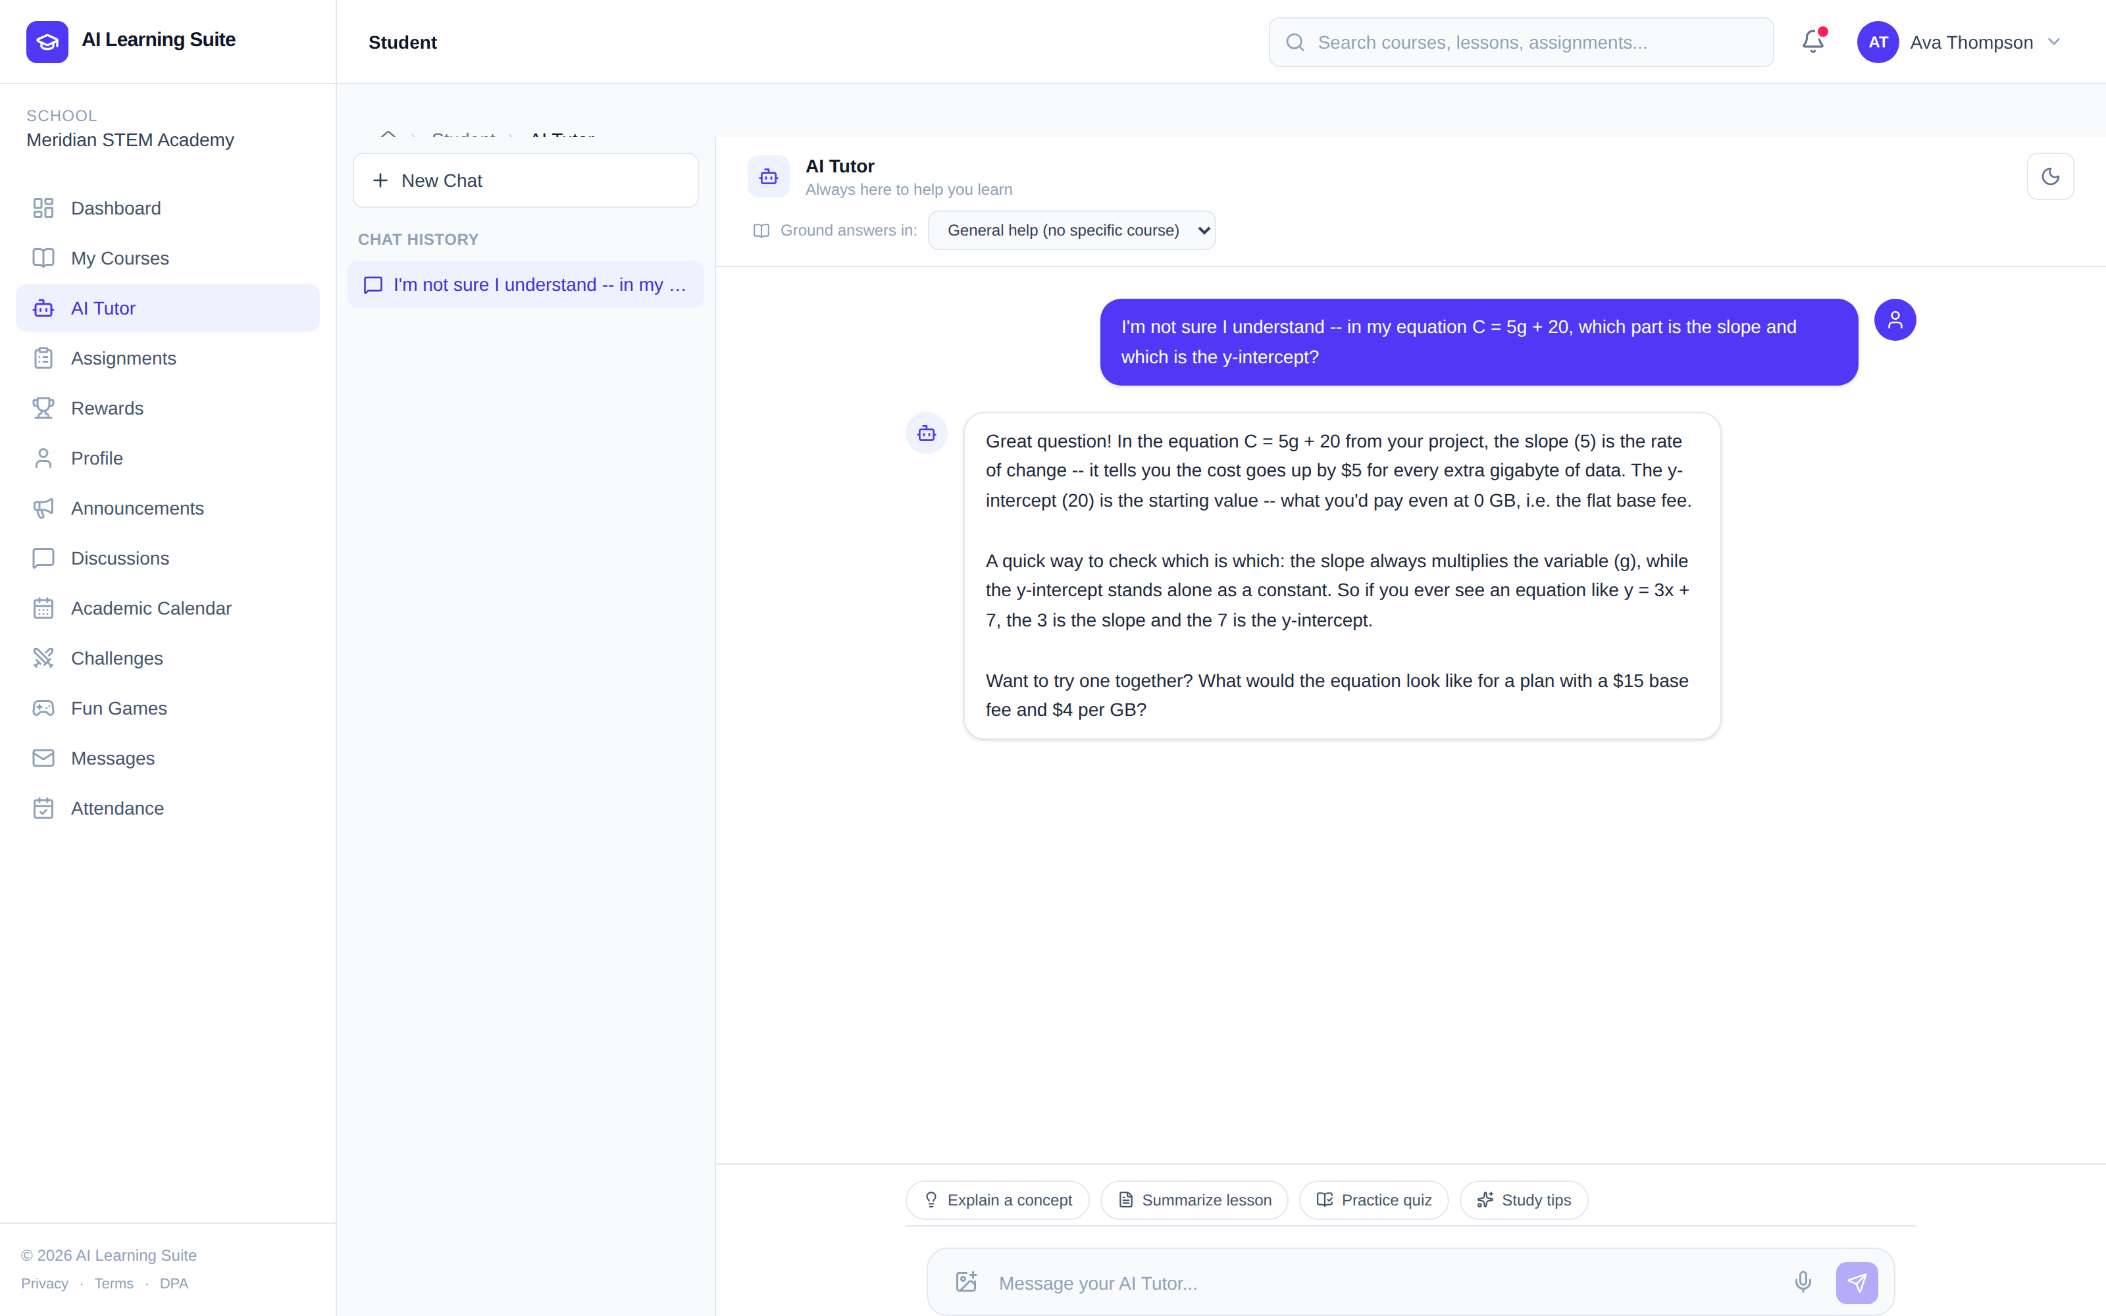
07 · RESULTS OBTAINED (INTERMEDIATE) — 2/3
Application Walkthrough
Teacher — AI Course Builder in action
Student — AI Tutor chat
Captured from a live, seeded instance of the application. AI-generated content (course builder, tutor chat, rubric suggestions) shown here was pre-seeded for demonstration rather than generated live, to conserve API quota.
AI Learning Suite
14 / 20

Slide 16
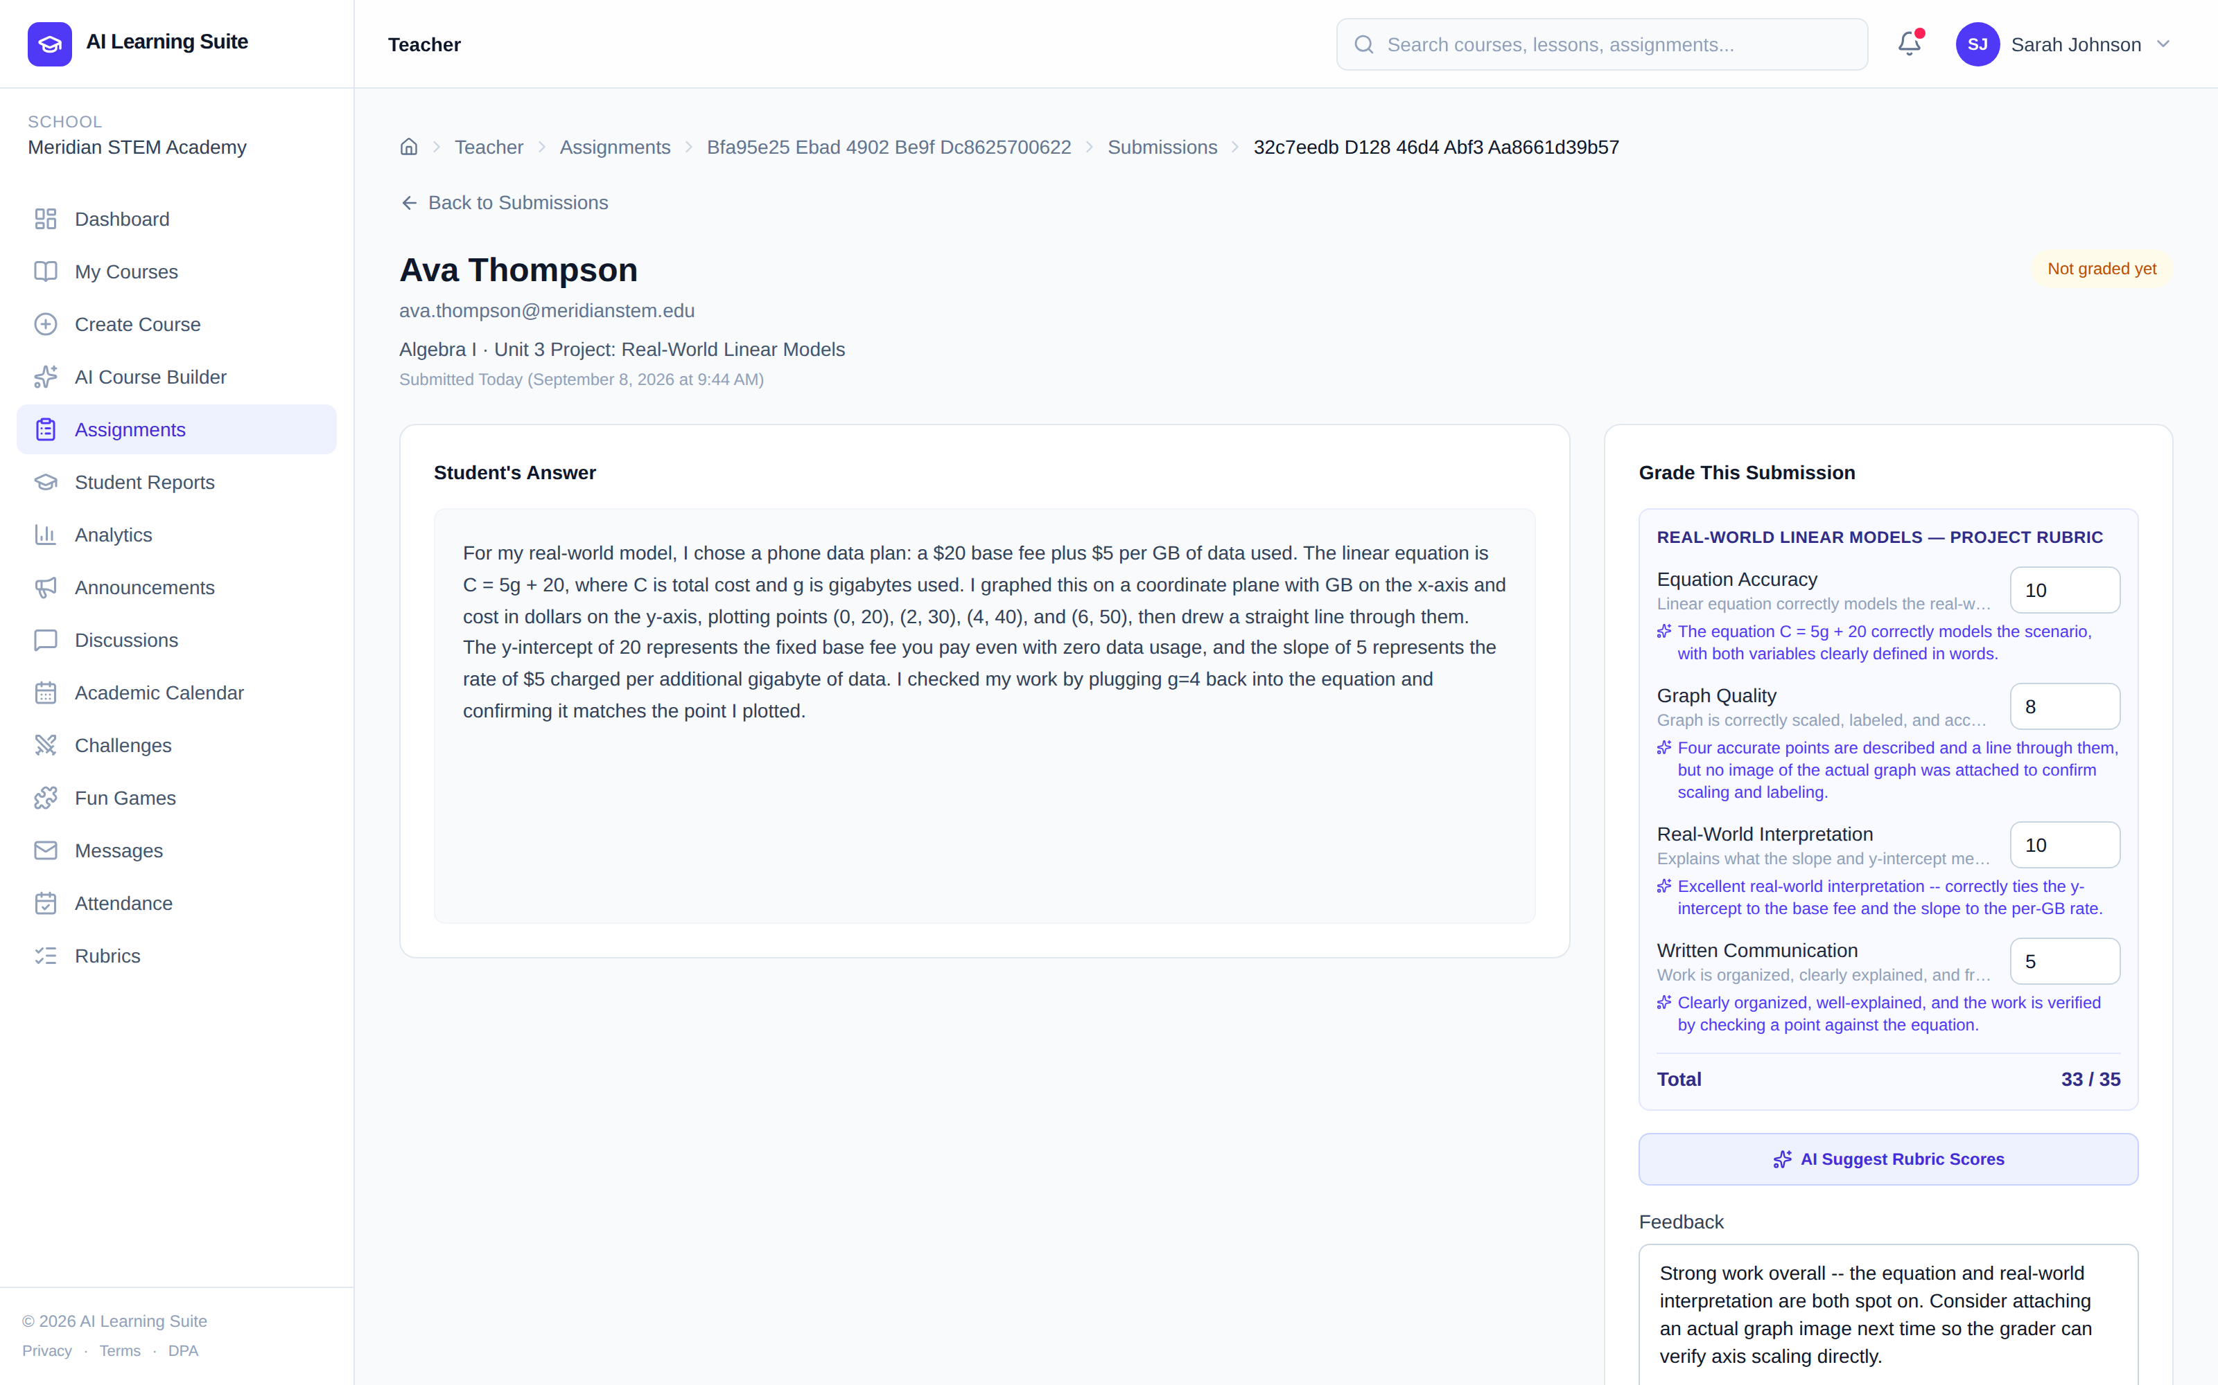
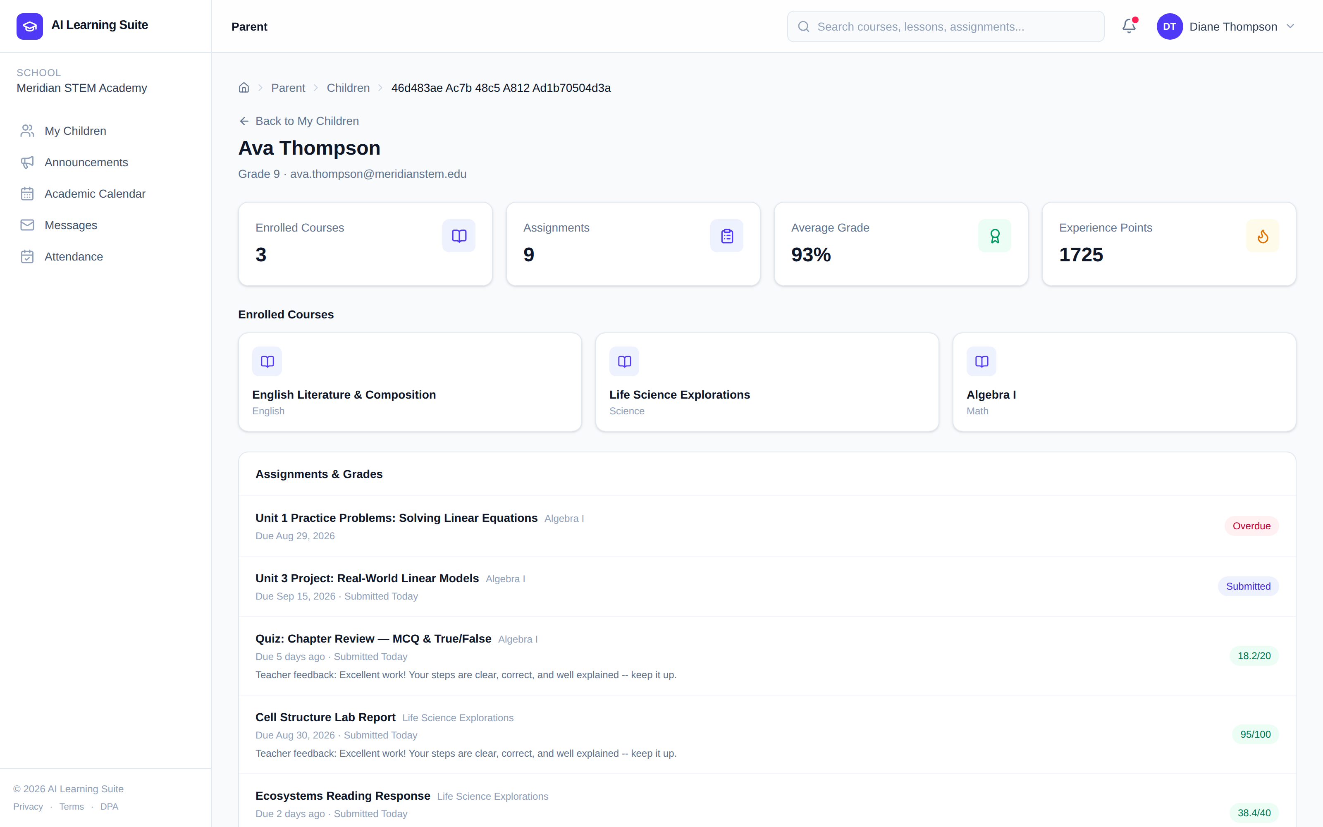
07 · RESULTS OBTAINED (INTERMEDIATE) — 3/3
Application Walkthrough
Teacher — Rubric grading with AI suggestions
Parent — Child's grades & attendance
Captured from a live, seeded instance of the application. AI-generated content (course builder, tutor chat, rubric suggestions) shown here was pre-seeded for demonstration rather than generated live, to conserve API quota.
AI Learning Suite
15 / 20

Slide 17
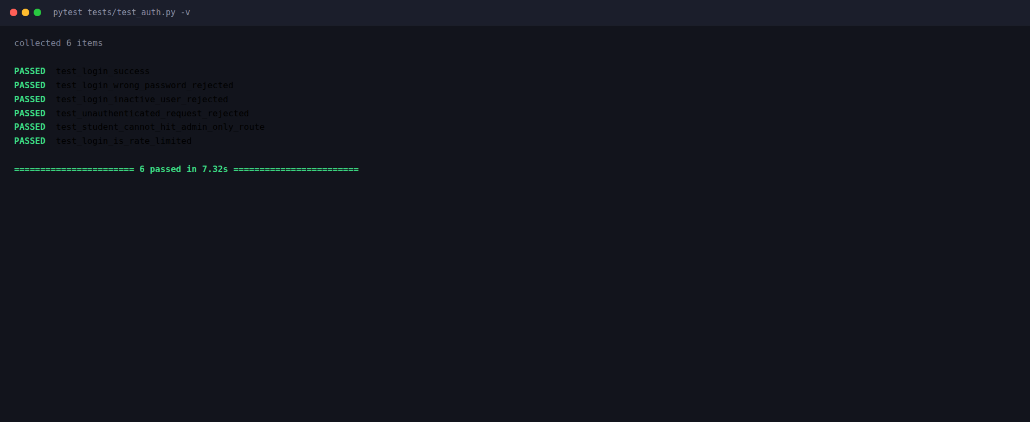
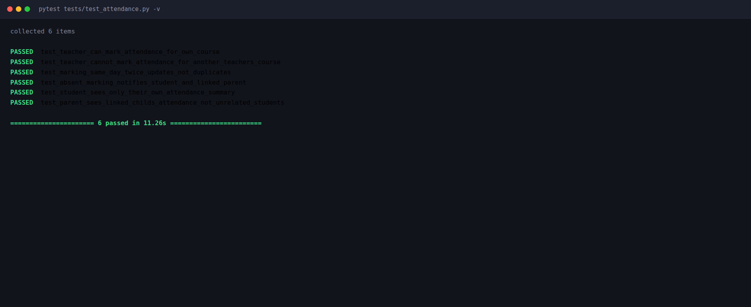
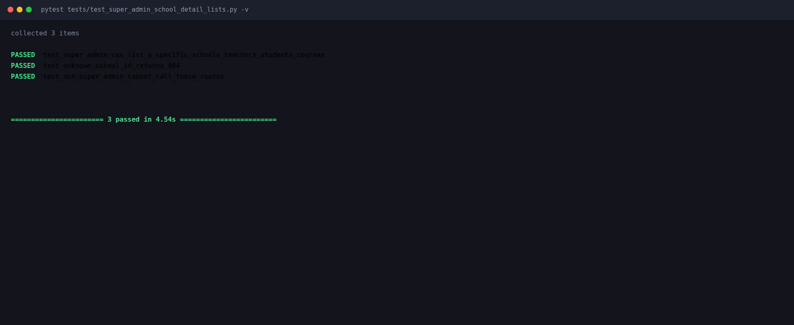
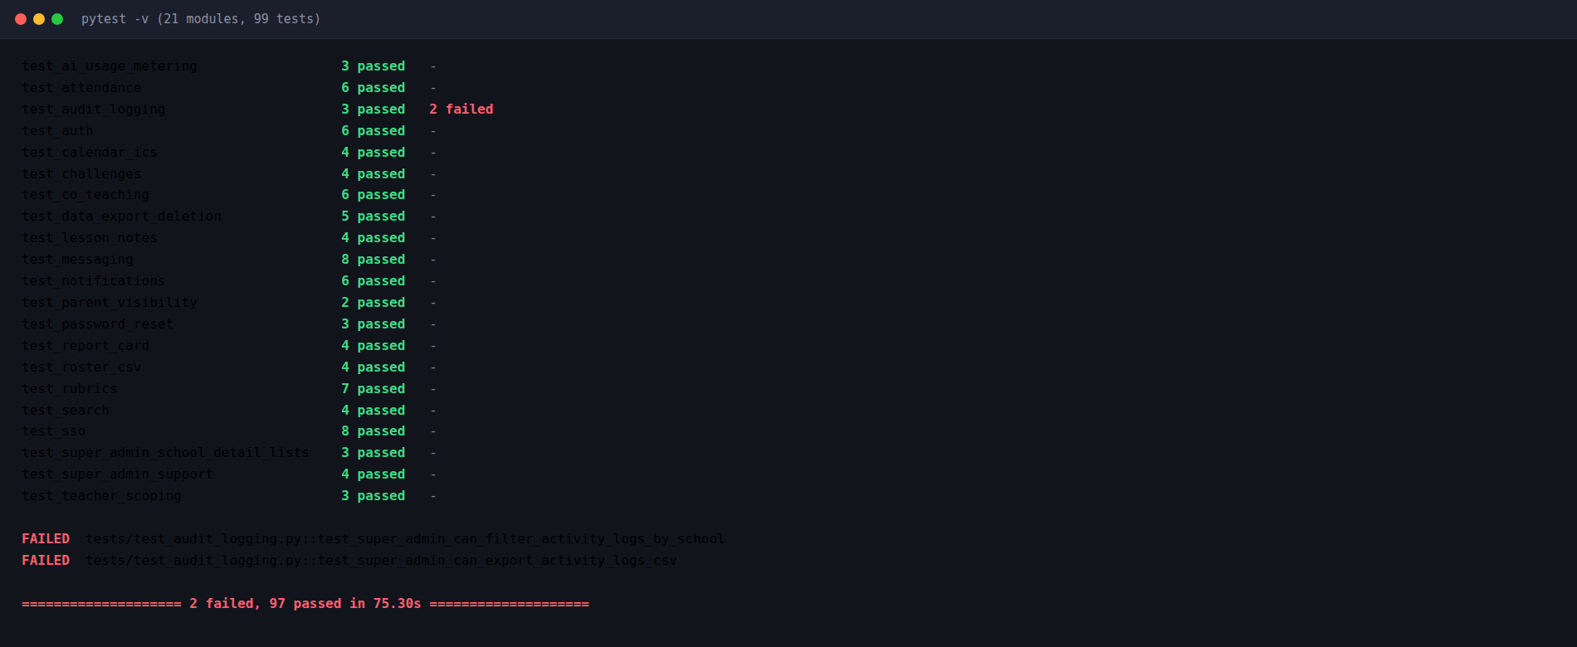
08 · UNIT TESTING
Module-Level Test Coverage
test_auth.py — login, RBAC route guards
test_attendance.py — mark / view attendance
test_super_admin_school_detail_lists.py — school detail tabs
pytest run summary — 21 modules, 99 tests, passed / failed count
Real pytest output from the project's own test suite (99 tests across 21 modules), run against an isolated throwaway SQLite database — never the live Postgres data.
AI Learning Suite
16 / 20

Slide 18
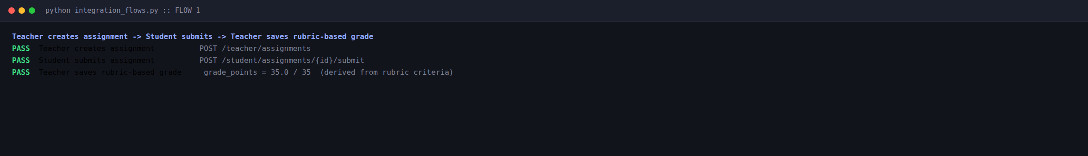
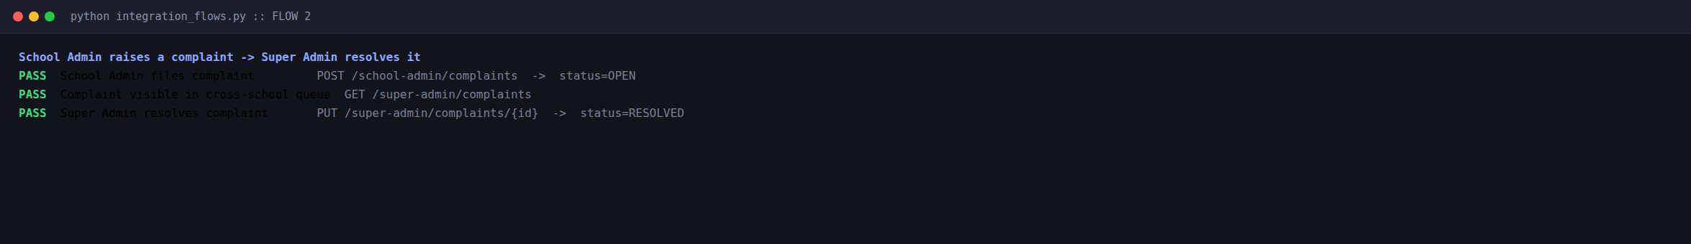
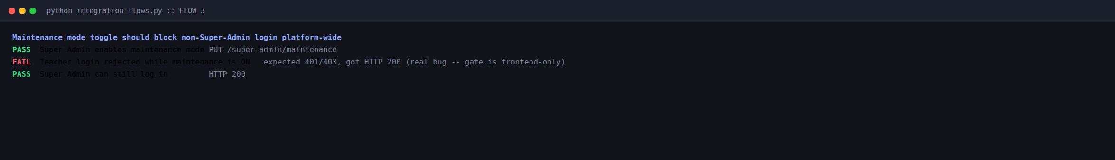
09 · INTEGRATION TESTING
End-to-End Flow Verification
Teacher creates assignment → Student submits → Teacher saves rubric-based grade
School Admin raises a complaint → Super Admin resolves it
Maintenance mode toggle should block non-Super-Admin login platform-wide — real gap found
Real, live API calls against the seeded demo instance (not mocked) — chained across roles per flow. Flow 3 surfaced a genuine gap: maintenance mode is currently enforced only in the frontend.
AI Learning Suite
17 / 20

Slide 19
10 · REFERENCES
References
FastAPI — Official Documentation
fastapi.tiangolo.com
SQLAlchemy 2.0 — Official Documentation
docs.sqlalchemy.org
Alembic — Database Migrations for SQLAlchemy
alembic.sqlalchemy.org
React — Official Documentation
react.dev
Tailwind CSS — Official Documentation
tailwindcss.com
PostgreSQL — Official Documentation
postgresql.org/docs
Anthropic — Claude API Documentation
docs.anthropic.com
Google AI — Gemini API Documentation
ai.google.dev
Add 2–3 papers from your literature review on AI-assisted grading and adaptive learning platforms.
AI Learning Suite
18 / 20

Slide 20
Thank You
Questions & Discussion
AI Learning Suite · Angeline Jenita · [Review Date]

